Slide 1
Solutions Suspensions Colloids
MIXTURES

Slide 2
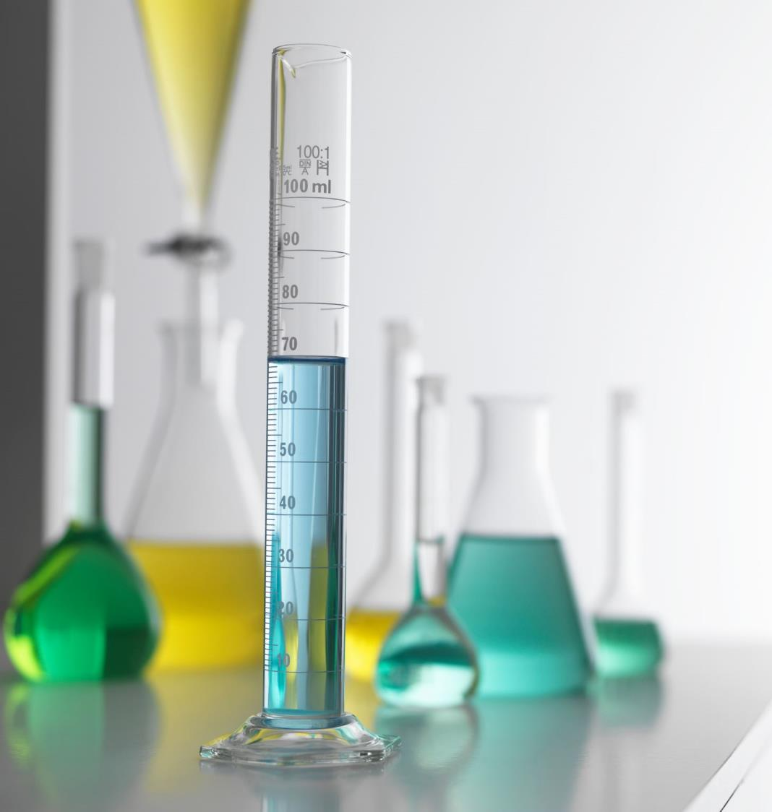
Solutions
When substances dissolve and form a homogeneous mixture, the mixture is called a solution
Whatever substance there is more of, is called the solvent. Whatever substance there is less of, is called the solute

Slide 3
Properties of a Solution
Transparent - Light passes through them
They do not separate into layers over time
If they are poured through a filter, everything passes through, none of the particles will get trapped

Slide 4
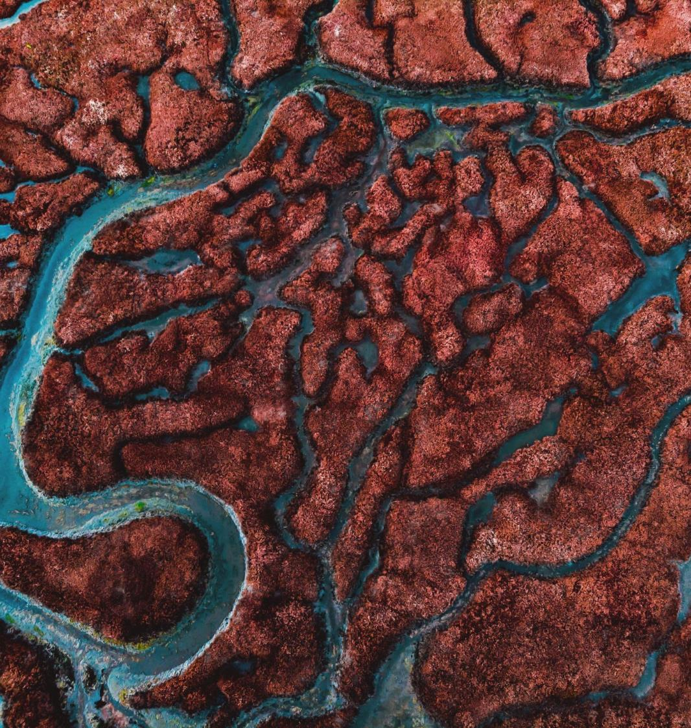
Suspensions
Suspensions are mixtures in which you can see the particles in the mixture
For example - Muddy water taken from a swamp is a good example

Slide 5
Properties of a Suspension
There are visible particles
The suspended particles settle out over time
Filters can separate particles that make up a suspension
Scatter light

Slide 6
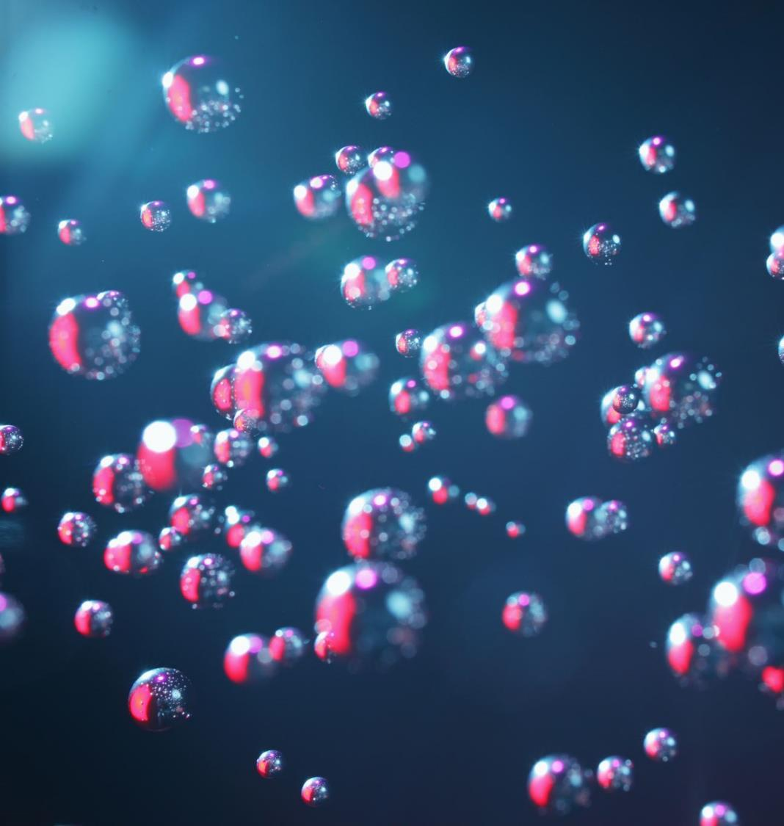
Colloids
Colloids are not transparent, but you cannot see the particles in them
They have very small particles in them that will not settle out or be filtered out
Examples include Milk , smooth peanut butter, vegemite, honey, pudding, whipped cream, and even fog!

Slide 7
Properties of Colloids
Particles cannot be filtered out
Scatter light
The particles are not visible
Colloids do not separate into layers

